Slide 1
How Climate Change Mitigation Affects Health
Jeremy Hess, MD, MPH
Associate Professor, Global Health, SOM & SPH
Associate Professor, Internal Medicine, Division of Emergency Medicine, SOM
Associate Professor, Environmental and Occupational Health Sciences, SPH

Slide 2
Overview: Key Questions
Is climate change mitigation good for health?
Will health co-benefits outweigh the mitigation costs?
Which strategies should we prioritize?
What are the knowledge gaps?

Slide 3
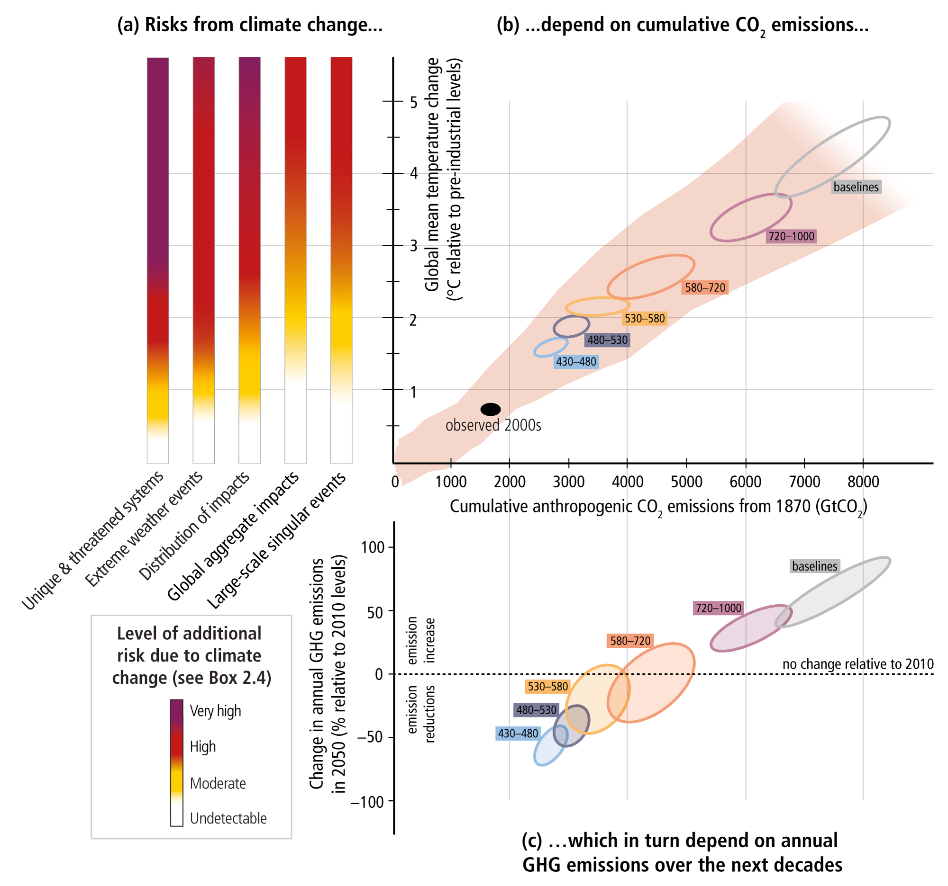
Emissions and Risks
IPCC AR5 WGIII

Slide 4
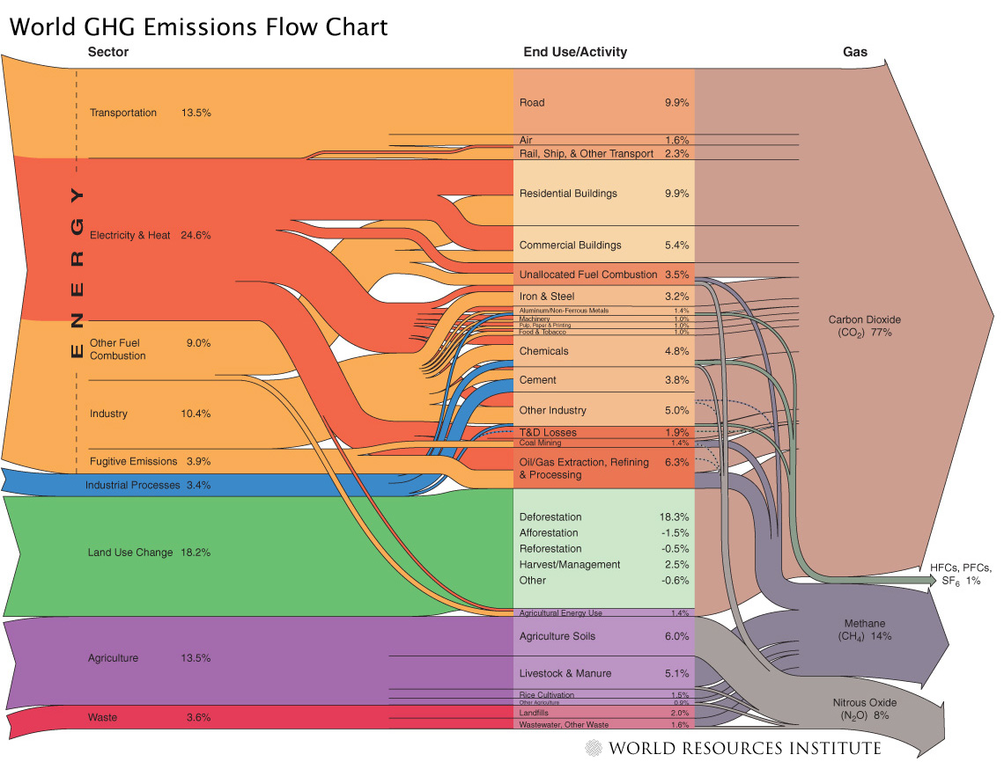

Slide 5
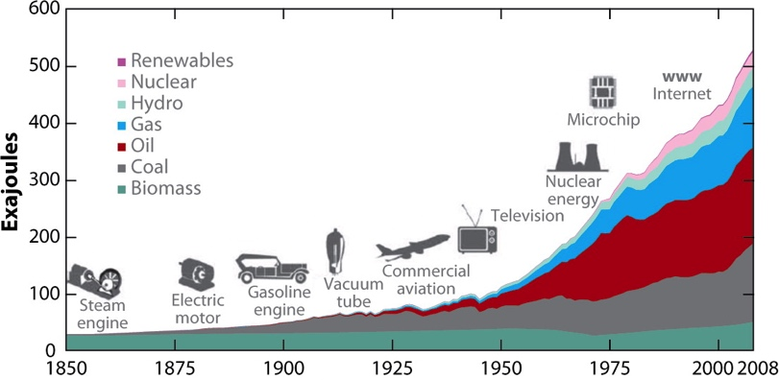
Energy Use Over Time
Year
Smith et al. Energy and Health. Ann Rev Public Health 2013; 34:159-88.

Slide 6
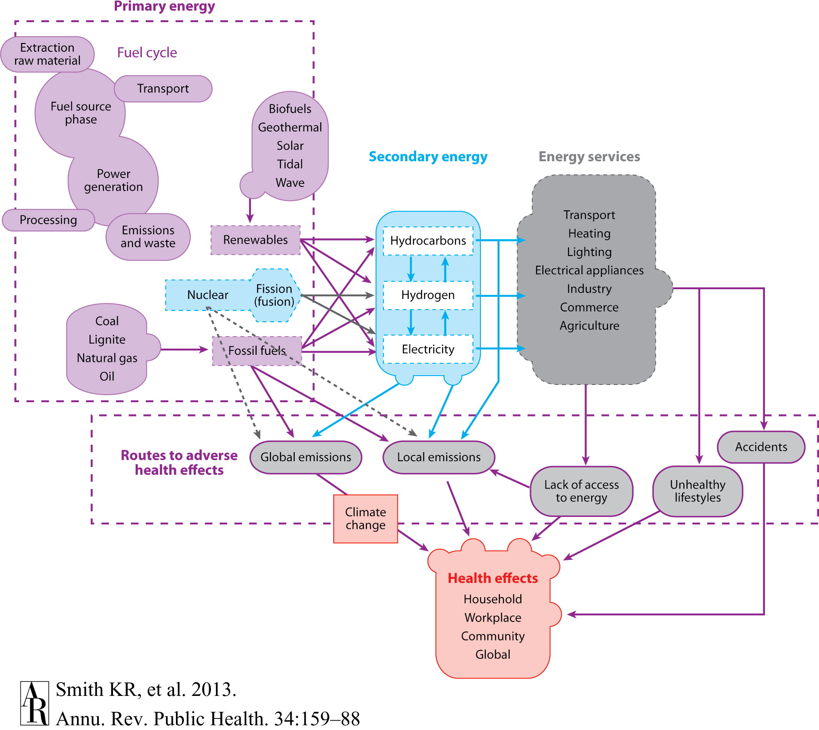
Smith et al. Energy and Health. Ann Rev Public Health 2013; 34:159-88.

Slide 7
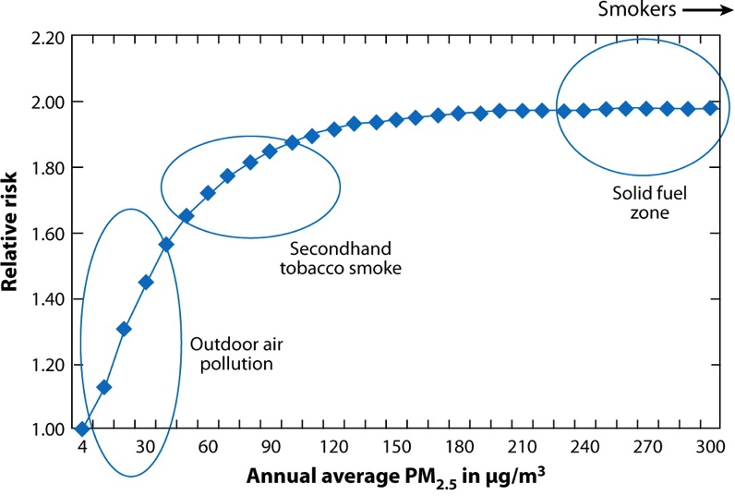
Risks of Biomass Burning
Smith et al. Energy and Health. Ann Rev Public Health 2013; 34:159-88.

Slide 8
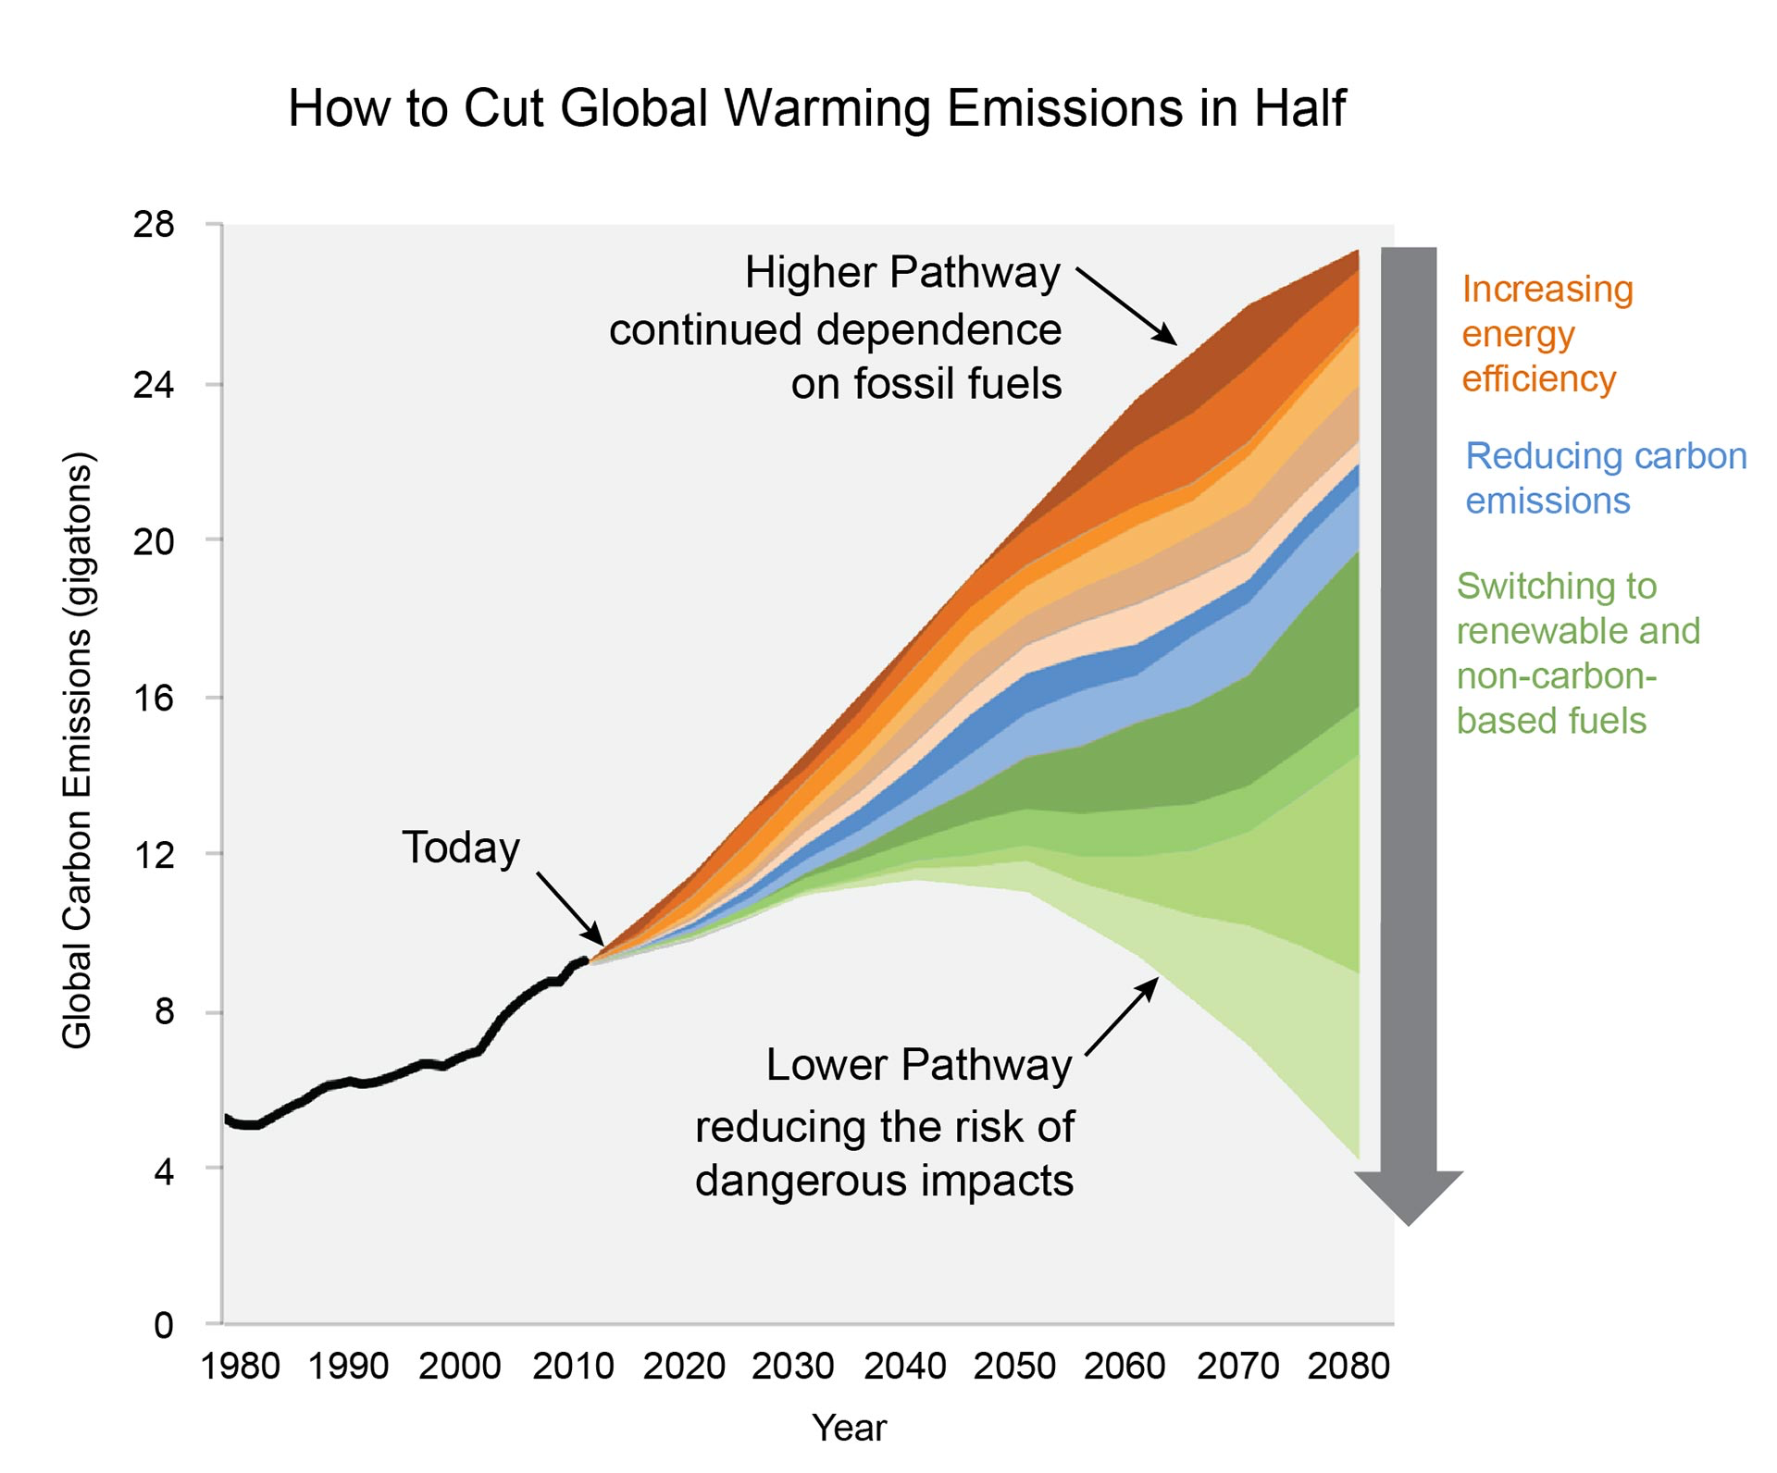

Slide 9
A Triumphant Moment

Slide 10
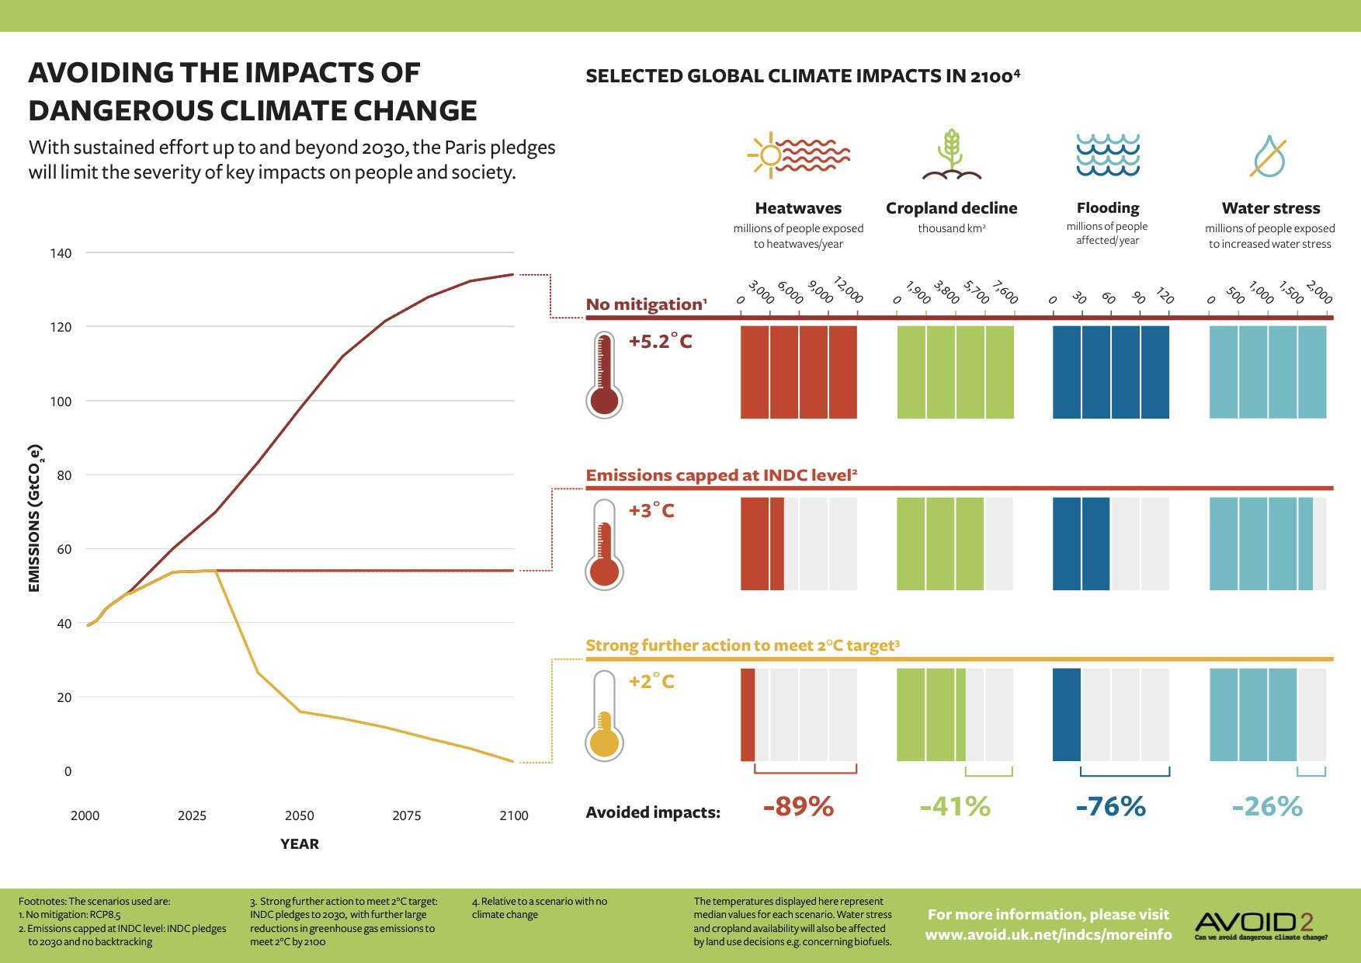
But Also Precarious

Slide 11
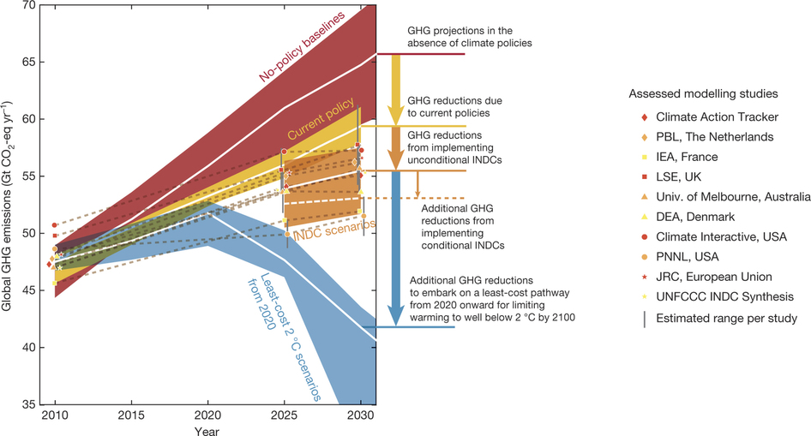
More Leverage is Needed Now
Rogelj, J., M. den Elzen, N. Höhne, et al. 2016. Paris Agreement climate proposals need a boost to keep warming well below 2 C. Nature. 534: 631-639.

Slide 12
And Through 2050
Rogelj, J., M. den Elzen, N. Höhne, et al. 2016. Paris Agreement climate proposals need a boost to keep warming well below 2 C. Nature. 534: 631-639.

Slide 13
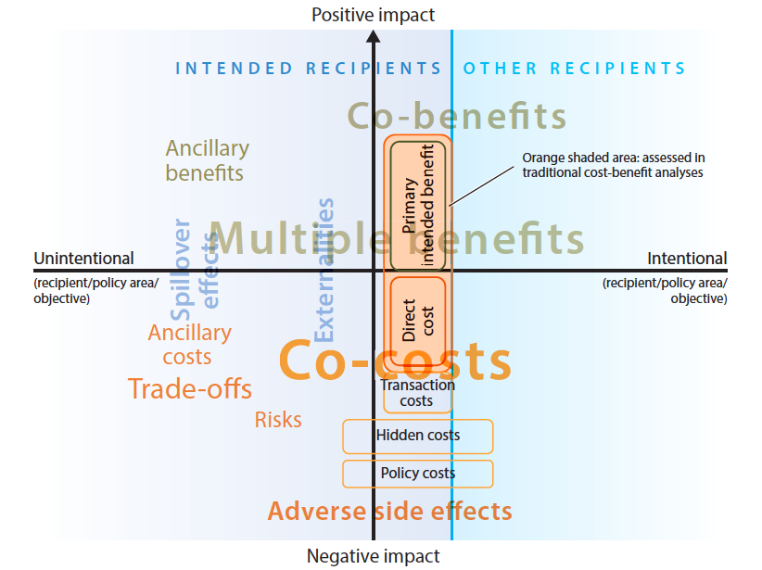
Mitigation Impacts: More than SCC
Ürge-Vorsatz, D., S.T. Herrero, N.K. Dubash, et al. 2014. Measuring the co-benefits of climate change mitigation. Annual Review of Environment and Resources. 39: 549-582.

Slide 14
“A Better World” – Costs & Benefits
Household energy
Urban land transport
Electricity generation
Agriculture and food
Short-lived GHGs
“The news isn’t all bad.”

Slide 15
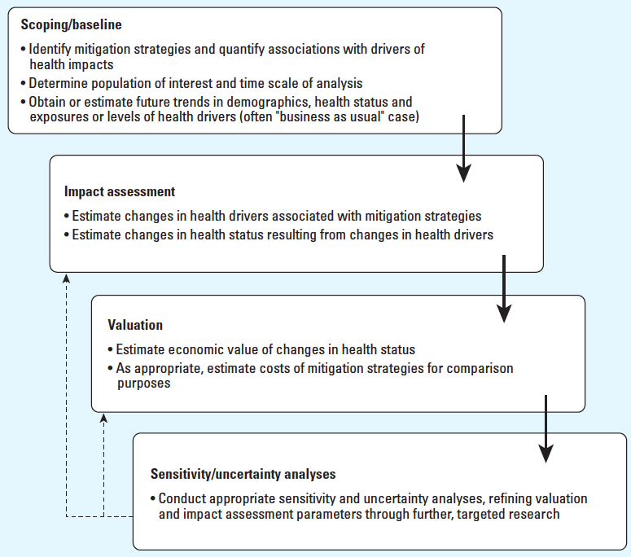
General Approach
Remais, J.V., J.J. Hess, K.L. Ebi, et al. 2014. Estimating the health effects of greenhouse gas mitigation strategies: addressing parametric, model, and valuation challenges. Environmental health perspectives.

Slide 16
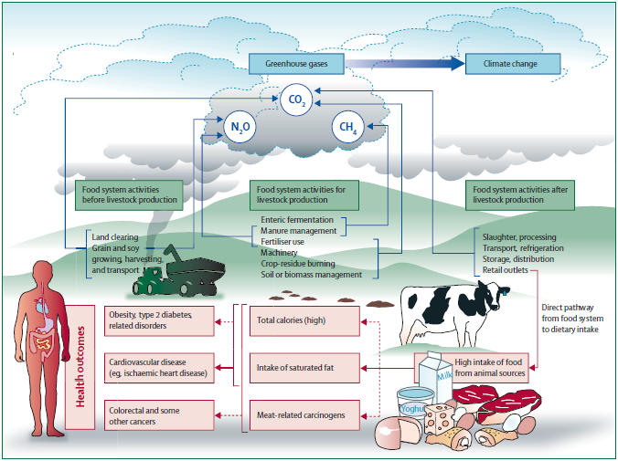
Food and Agriculture

Slide 17
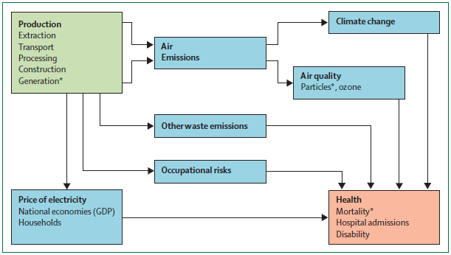
Electricity Generation

Slide 18
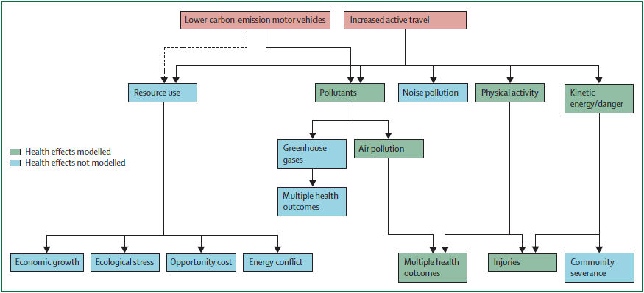
Transport

Slide 19
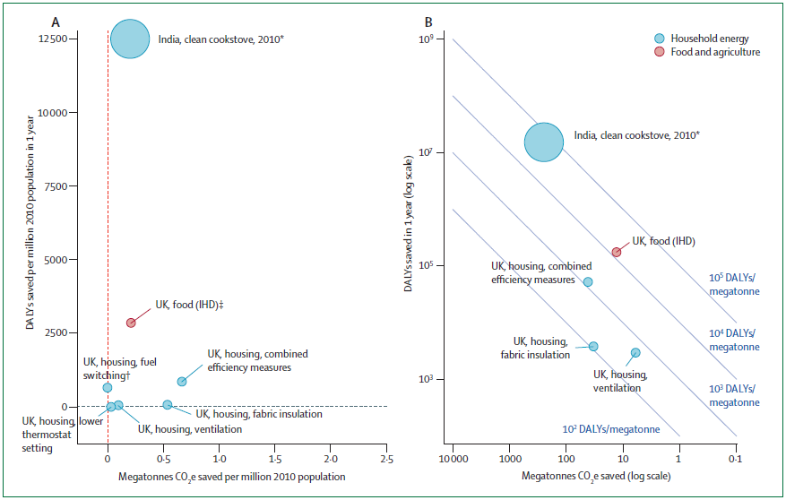

Slide 20
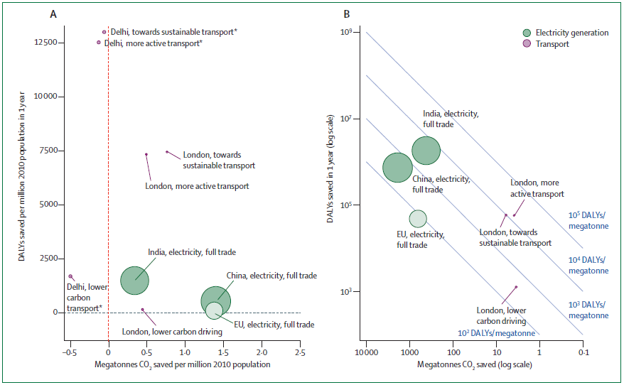

Slide 21
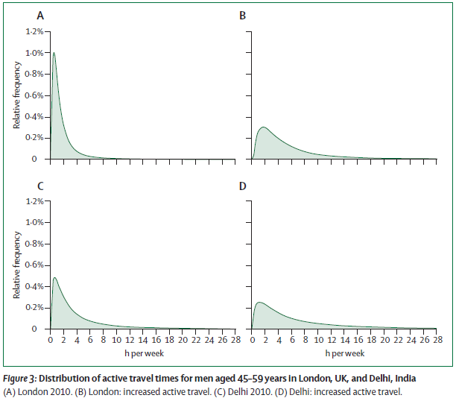
Tradeoffs, e.g. Travel Time

Slide 22
Diversity of Approaches
Wide range of scopes, from local to global
Starting points vary, but generally are either:
An emissions target, typically expressed as a proportion of historical emissions
A policy (e.g. a tax) aimed at achieving a reduction in consumption
A policy (e.g. cap and trade) aimed at promoting reductions and substitutions
A health policy target, e.g. a dietary change, already endorsed in practice or principal
Starting point often relates to primary goal of research, often modeling for insight, sometimes identifying net costs to policymakers, evaluating tradeoffs of different policy options, exploring differential impacts on specific populations

Slide 23
Summary of Findings
Substantial health co-benefits with almost all policies
GHG reductions range widely depending strategy, on magnitude of changes, and substitutions available
Significant welfare costs for some mitigation strategies (e.g. nutrition)
Estimates of co-benefits likely systematically low
Work has imbalanced focus on one aspect of modeling
Some mitigation strategies (e.g. nutrition) require transformative change
Substantial regional variation of impacts and costs found in economic modeling; differential effects need attention
Linkage of economic, emissions, exposure, and health impact modeling yields most comprehensive insights, yet these end-to-end models are not widely available
Return on investment difficult to determine without more credible economic modeling

Slide 24
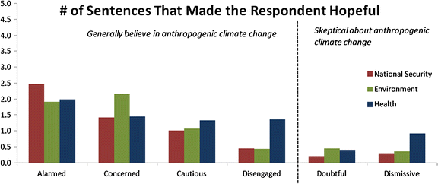
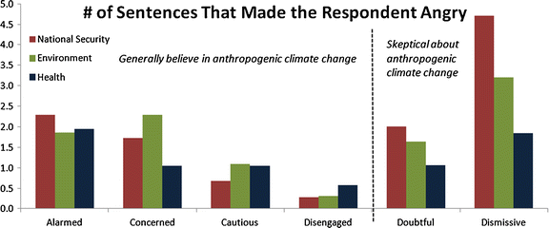
Communicating via a Public Health Frame
A public health frame for communicating climate change impacts and the health co-benefits of mitigation resonated most broadly across a wide range of audiences in experimental conditions
Myers, T.A., M.C. Nisbet, E.W. Maibach, et al. 2012. A public health frame arouses hopeful emotions about climate change. Climatic Change. 113: 1105-1112.

Slide 25
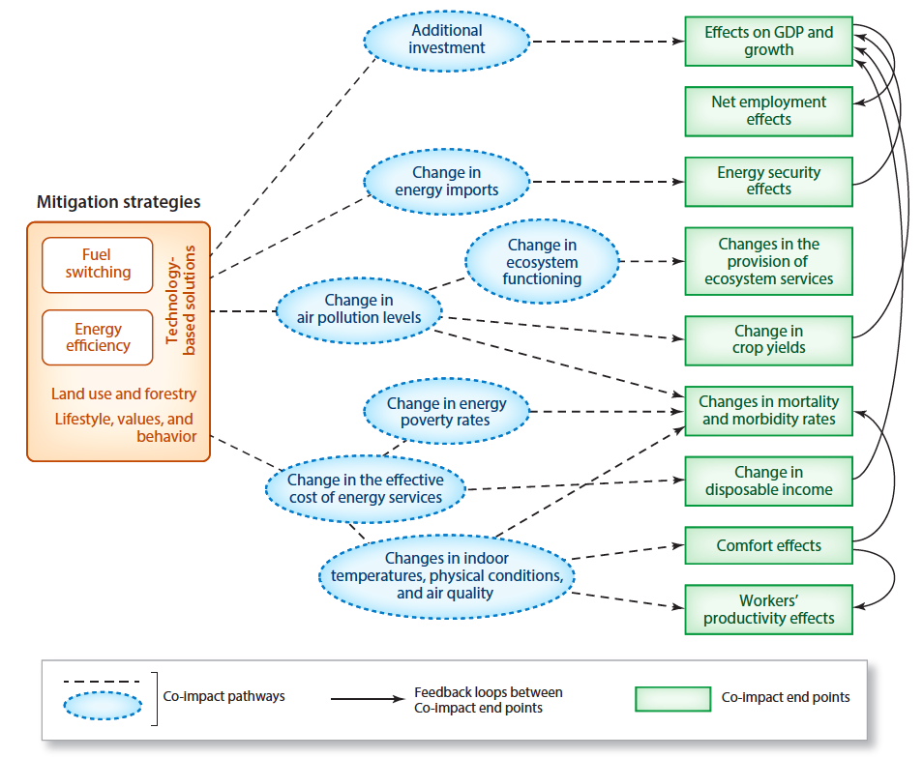
Complex Pathways
Legend
Ürge-Vorsatz, D., S.T. Herrero, N.K. Dubash, et al. 2014. Measuring the co-benefits of climate change mitigation. Annual Review of Environment and Resources. 39: 549-582.

Slide 26
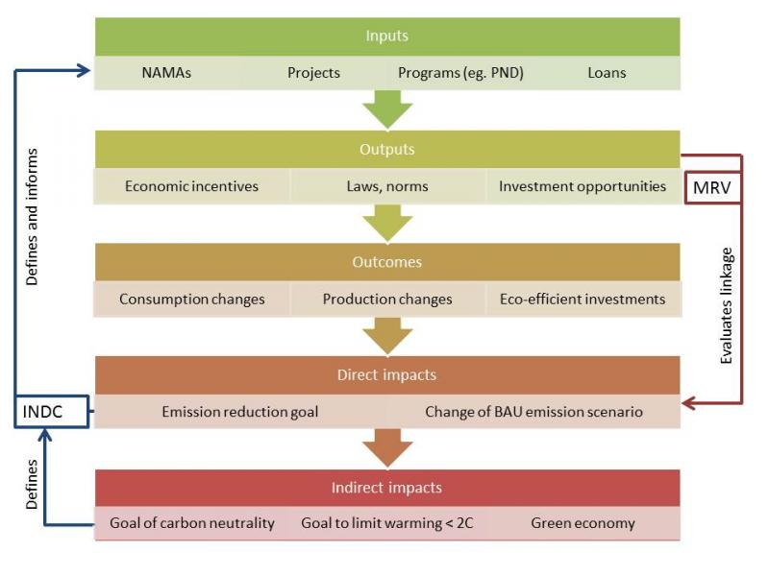
asdfasdf
Available here

Slide 27
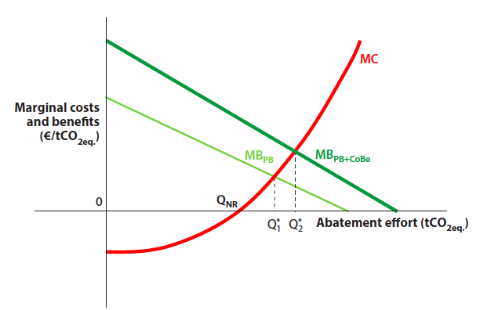
Economic Perspective
Including co-benefits shifts the marginal benefits curve up
Result is shift in optimal abatement, balance of marginal costs and marginal benefits, from Q₁ to Q₂
Ürge-Vorsatz, D., S.T. Herrero, N.K. Dubash, et al. 2014. Measuring the co-benefits of climate change mitigation. Annual Review of Environment and Resources. 39: 549-582.

Slide 28
Other Advantages
Including co-benefits, particularly for impacts that accrue quickly, helps counter loss aversion among policymakers
Emphasizing co-benefits can counter implicit discounting of primary benefits both in space and time
Climatic stability is an underprovided global public good; emphasizing co-benefits can localize positive impacts and counter the tragedy of the commons
Ürge-Vorsatz, D., S.T. Herrero, N.K. Dubash, et al. 2014. Measuring the co-benefits of climate change mitigation. Annual Review of Environment and Resources. 39: 549-582.

Slide 29
Where We Need to Go
Rogelj, J., M. den Elzen, N. Höhne, et al. 2016. Paris Agreement climate proposals need a boost to keep warming well below 2 C. Nature. 534: 631-639.

Slide 30
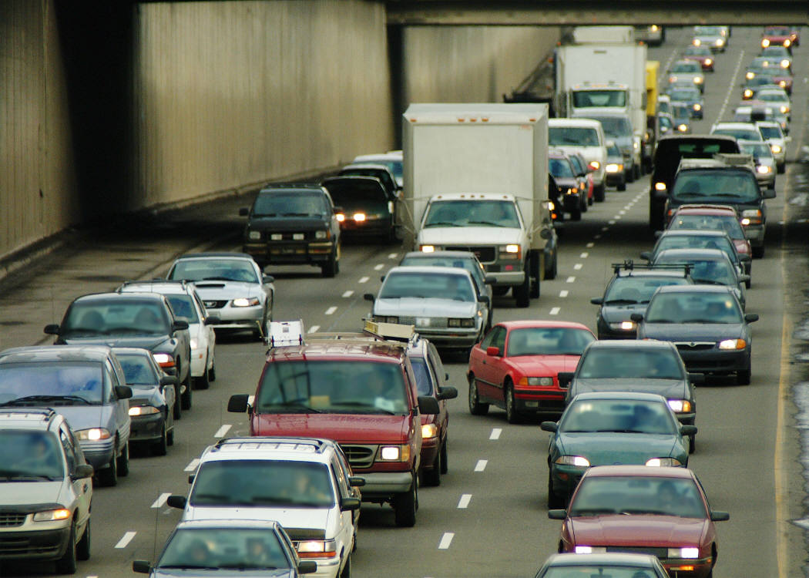
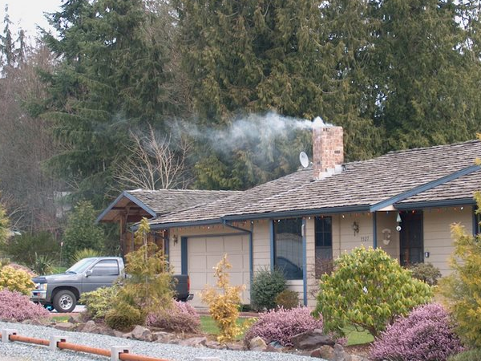
Greenhouse Gas and Air Pollution Sources Overview
Kathy Strange
Sustainable Path
2.1.17
Clean, healthy air
for everyone, everywhere,
all the time.

Slide 31
Overview
Who we are
Sources of greenhouse gas and air pollutant emissions
Impacts of pollution, highly impacted communities
Need for target and policy adjustments
The future . . . .
Clean, healthy air
for everyone, everywhere,
all the time.

Slide 32
Puget Sound Clean Air Agency
Puget Sound Region: King, Pierce, Snohomish and Kitsap counties
Compliance/Regulatory
Air Monitoring
Voluntary and Incentive Programs
Outreach
Strategic Plan guides us to protect air quality and climate
Clean, healthy air
for everyone, everywhere,
all the time.

Slide 33
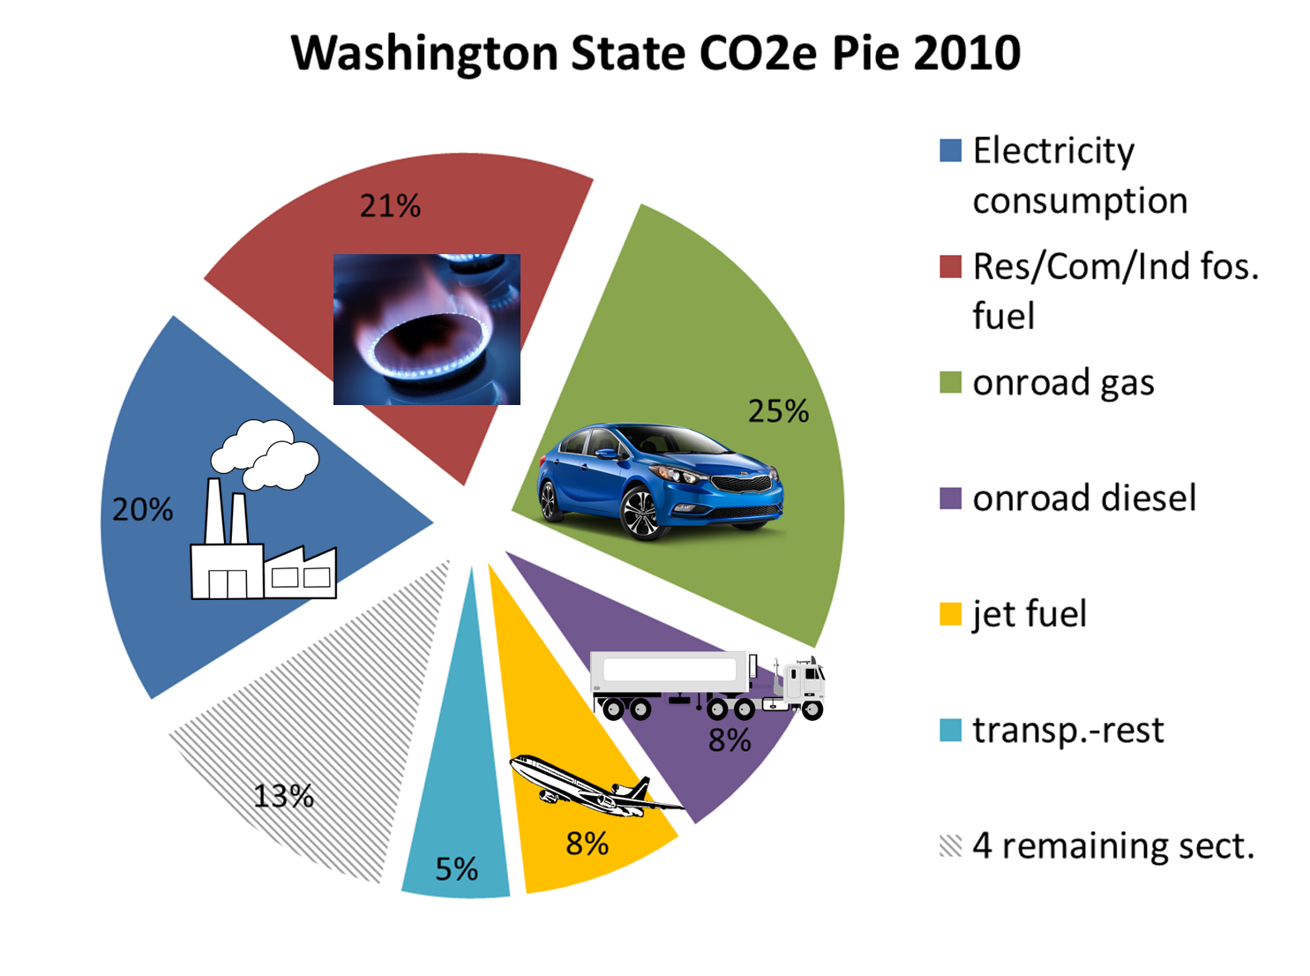
https://fortress.wa.gov/ecy/publications/documents/1602025.pdf

Slide 34
Where does air pollution come from?
Fine particles
wood burning stoves, also burn piles
diesel engines, gasoline vehicles, industrial sources
Air Toxics
diesel engines, gasoline vehicles, and industrial sources
Nitrogen dioxide
truck emissions, gasoline vehicles, industrial sources
2005 Air Emission Inventory for King, Kitsap, Pierce, and Snohomish Counties, PSCAA, March 2008; communications@pscleanair.org
Notes:
in our region, focus is on fine particles, ozone, and toxics

Slide 35
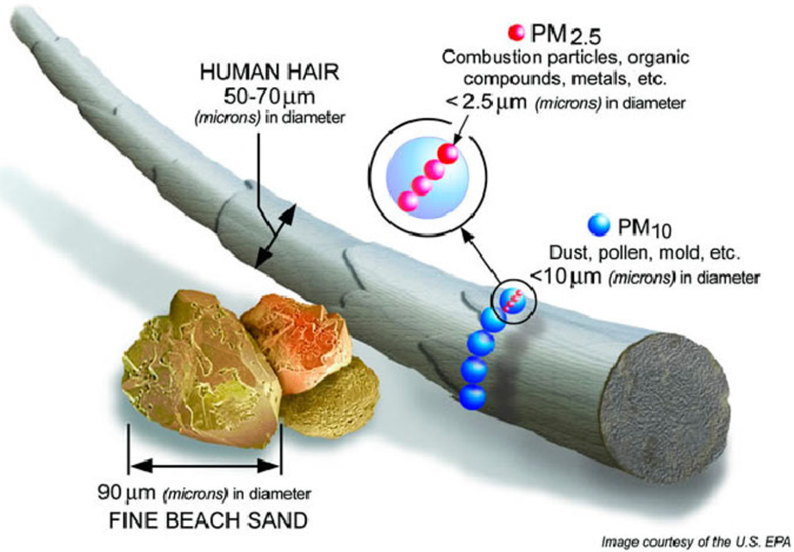
Health effects from fine particles
Reduced lung function
Asthma and COPD
Heart attacks
Strokes
Premature death
US EPA, “Integrated Science Assessment for Particulate Matter (Final Report)”, EPA/600/R-08/139F, Dec 2009.
https://www.epa.gov/pm-pollution/health-and-environmental-effects-particulate-matter-pm

Slide 36
Health effects from air toxics
Cancer risk
Reproductive risk
Immune system damage
https://www.epa.gov/urban-air-toxics/about-urban-air-toxics
https://www.arb.ca.gov/regact/diesltac/diesltac.htm

Slide 37
Annual Public Health Cost due to Transportation Air Pollution
In the Puget Sound Region:
~70 to 150 premature deaths
~11,600 lost work days
~2,400 asthma exacerbations
COBRA V2.7, June 2015; for King, Kitsap, Snohomish, and Pierce counties
https://www.epa.gov/statelocalclimate/co-benefits-risk-assessment-cobra-screening-model
Clean, healthy air
for everyone, everywhere,
all the time.

Slide 38
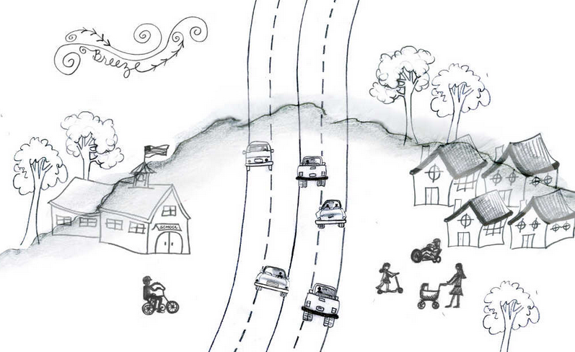
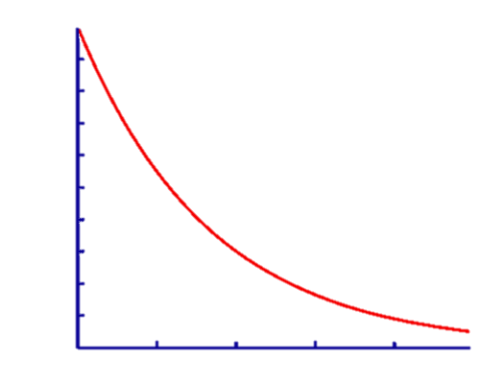
Burden not evenly borne
Amount of pollution
100 200 300 400 500
Distance to road (yards)
Karner, et al. “Near-Roadway Air Quality: Synthesizing the Findings from Real-World Data”, Environ Sci Technol, 2010, 44, 14, 5334-5344.
Centers for Disease Control and Prevention, “CDC Health Disparities and Inequalities Report – United States”, MMWR, November 22, 2013.
Notes:
Roads a big source, and pollution drops with distance, but…

Slide 39
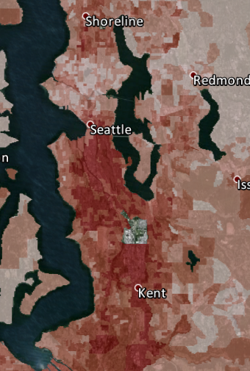
Equity is an issue
From the Puget Sound Clean Air Agency, Most impacted areas in dark red, Community Air Tool, 2012.

Slide 40
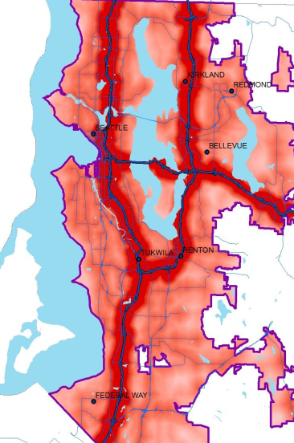
Equity is
an issue
Schulte, “Traffic Density, Census Demographics and Environmental Equity in Housing: A geographic analysis in King County”, November 2012, prepared for the King County Equity and Social Justice Initiative

Slide 41
Address Adequacy of Targets
on the books regulations
recent path
CAFE std.
WA Ren. Fuel
Building Eff.
Clean Air Rule
A
B
C
H
Notes:
note Everett and Tacoma are similar to King County
Transportation
Federal standards for vehicle efficiency (e.g. CAFE, heavy duty diesel) reduces fuel usage and emissions
vehicle electrification: for hydro power (e.g. Seattle City Light) is near-zero pollution, for others, reduces carbon, total pollution, and near-road exposures
public transit: reduce gas usage
Weatherization and insulation initiatives reduce heating demand for all fuels/sources, and also reduces wood burning need and particle pollution
High efficiency gas furnaces and heat pumps make these choices more appealing/affordable = less burning
bio(renewable) jet fuel may reduce aircraft emissions
solar, wind, & nuclear electrical generation reduce air emissions
zoning/planning improvements reduce congestion, enable public transit, reduce VMT and emissions
Clean Air Rule:
mandated slow stepping down of emissions of largest sources
spurs improvements in efficiency => reduces fuel use => almost always reduces all pollutants
Renewable Portfolio Standard:
mandated reduction in carbon intensity of electrical generation
reduces use of coal and natural gas generation => incentivizes non-polluting electricy generation

Slide 42
How to get there (an example)
California 2030
Double building energy efficiency
Increase wind and solar, add storage, end fixed fossil fuel generation
Go to all electric water heating, 50% of natural gas will be biogas
4.2 million ZEVs (about 20% of all vehicles, and roughly equal to all WA state cars)
Biofuels for vehicles (4 billion gallons, ~ 2x WA state total)
https://www.arb.ca.gov/cc/scopingplan/2030sp_pp_final.pdf

Slide 43
How to get there (an example)
California 2030
Double building energy efficiency
Increase wind and solar, add storage, end fixed fossil fuel generation
Go to all electric water heating, 50% of natural gas will be biogas
4.2 million ZEVs (about 20% of all vehicles, and roughly equal to all WA state cars)
Biofuels for vehicles (4 billion gallons, ~ 2x WA state total)
https://www.arb.ca.gov/cc/scopingplan/2030sp_pp_final.pdf

Slide 44
THE FUTURE
Will need ambitious targets with the supporting policies and programs to achieve
Where fossil fuel combustion is reduced, there is a strong co-benefit of air pollutant reduction

Slide 45
Thank you for your attention
Kathy Strange
KathyS@pscleanair.org
Clean, healthy air
for everyone, everywhere,
all the time.

Slide 46
Health Benefits of Climate Change Policies: A Built Environment Perspective
Andrew L. Dannenberg, MD, MPH
Affiliate Professor
Dept. of Environmental and Occupational Health Sciences Dept. of Urban Design and Planning
University of Washington
adannen@uw.edu
Seattle Town Hall, February 1, 2017

Slide 47
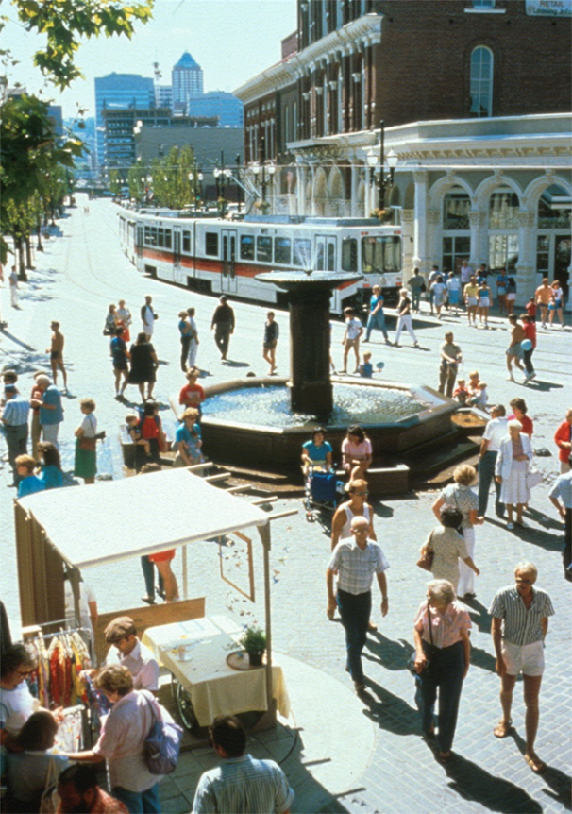
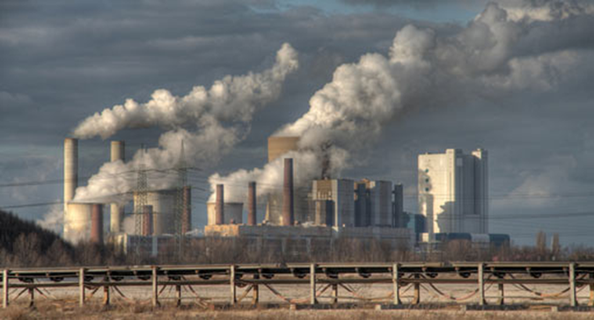
Built Environment
Settings designed, created, modified, and maintained by human efforts, such as homes, schools, workplaces, parks, neighborhoods, roads, and transit systems

Slide 48
Climate Change Policies
Built Environment
Public Health
Co-Benefits

Slide 49
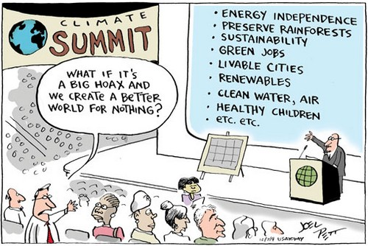
Notes:
Overall, the steps we need to take to address climate change—both mitigation and adaptation—offer great promise for health and well-being. Addressing climate change is an enormous public health opportunity. This is a good news story.

Slide 50
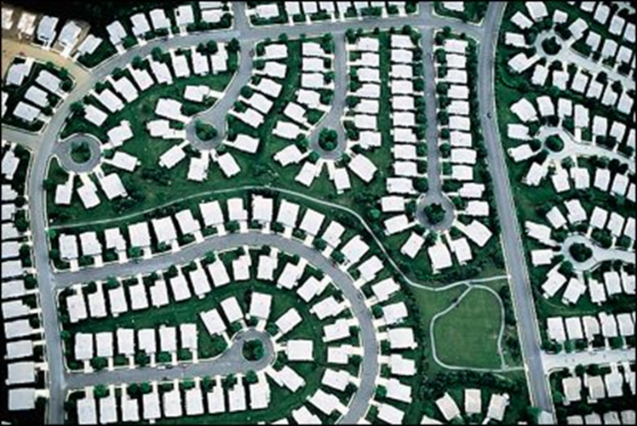
Built Environment
Transportation
Buildings
Land use, forestry
and agriculture

Slide 51
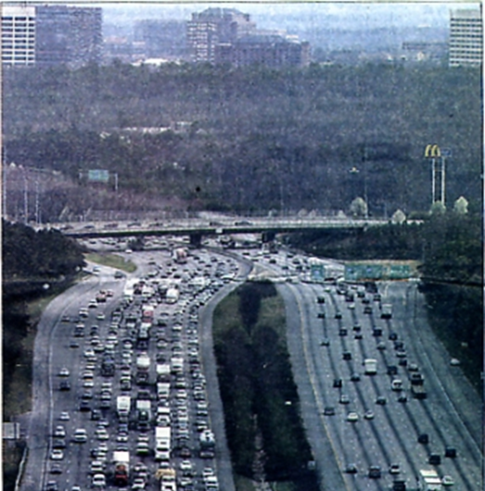
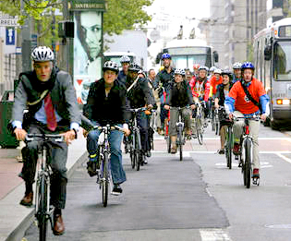
Transportation Links to GHG emissions and climate change
● Fuel consumption associated with personal and commercial vehicle use
● Number of vehicle miles traveled per capita
● Long distances between homes, jobs, schools, and other destinations
● Long distances from farm and factory to market

Slide 52
Built Environment Strategies to Improve Transportation and Health
● Decrease distances between destinations (denser and mixed-use development)
● Increase facilities for transit use, walking, bicycling
● Promote safe routes to school programs
● Increase use of rail for transport of people and goods
● Promote telecommuting
● Decrease air travel
● Promote use of food and goods from local suppliers
● Develop infrastructure for alternative fuel distribution

Slide 53
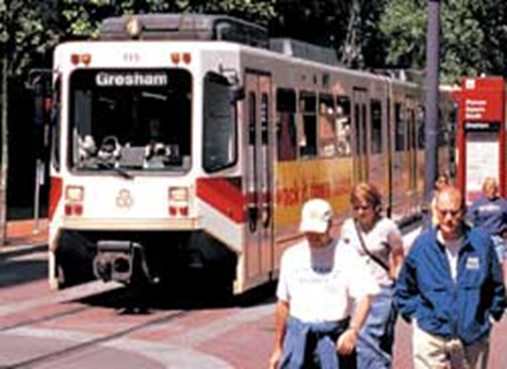
Potential Transportation Impacts
Climate benefits
↓ CO₂ emissions
Other environmental benefits
↓ air pollution
↓ resource use
Health benefits
↑ physical activity
↓ air pollution
↓ motor vehicle crashes
↑ social capital

Slide 54
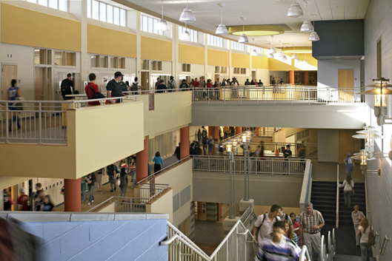
Buildings Links to GHG emissions and climate change
● Energy use in producing and transporting construction materials (“embedded energy”)
● Energy use in construction practices
● Energy use in heating and cooling
● Energy use in building operations, lighting, elevators
● Building site choices that promote auto dependency

Slide 55
Built Environment Strategies to Improve Buildings and Health
● Increase use of sustainable, local, and/or recycled construction materials and reuse of older buildings
● Increase energy efficiency: site orientation, insulated windows, green roofs, natural ventilation
● Decrease occupant electricity use: convenient stairs, efficient bulbs, daylighting, motion-sensor light switches
● Adopt LEED guidelines for energy-efficient buildings
● Use less square footage when building houses
● Reduce drive-through services: idling autos

Slide 56
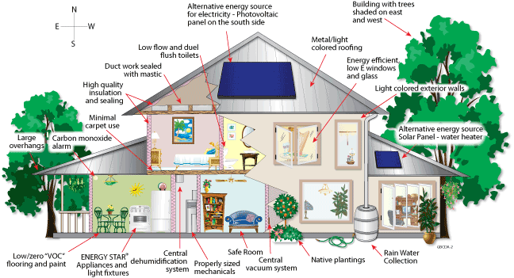
Buildings Green energy-efficient design

Slide 57
Impacts of Green Buildings
Climate benefits
↓ carbon footprint
Other environmental benefits
Raw material conservation
↓ air pollution
Urban stormwater management
Health benefits
↓ toxic exposures
Improved indoor air quality
↑ comfort
Routine physical activity
Natural lighting and mental health
Notes:
http://www.myfloridagreenbuilding.info/

Slide 58
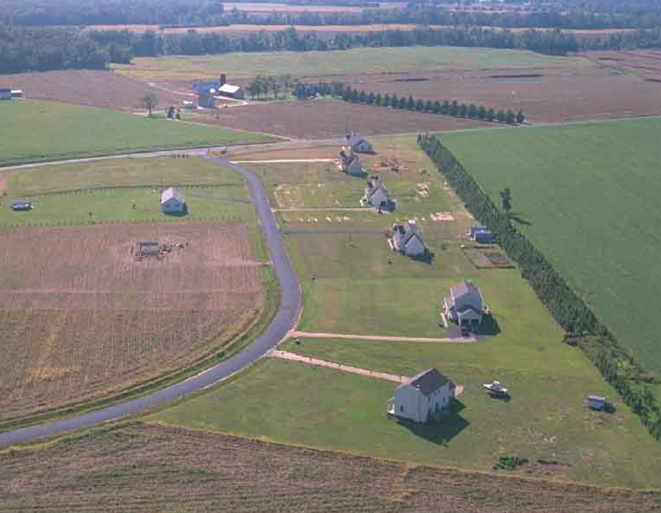
Land Use, Agriculture, and Forestry Links to GHG emissions and climate change
● Density is determined by zoning and affects travel
● Separation of land uses, which increases travel
● Deforestation from logging, agriculture, and sprawl
● Buildings constructed in vulnerable areas, such as coastal regions and flood plains

Slide 59
Built Environment Strategies to Improve Land Use, Forestry, Agriculture, and Health
● Develop mixed-use communities
● Follow Smart Growth and LEED-ND principles
● Preserve and expand parks, trails, and green space
● Coordinate regional planning
● Reduce construction in coastal locations, flood plains
● Encourage community gardens and farmers’ markets
● Provide incentives to protect, manage, sustain forests
● Support sustainable logging and agriculture
● Reduce demand for meat consumption

Slide 60
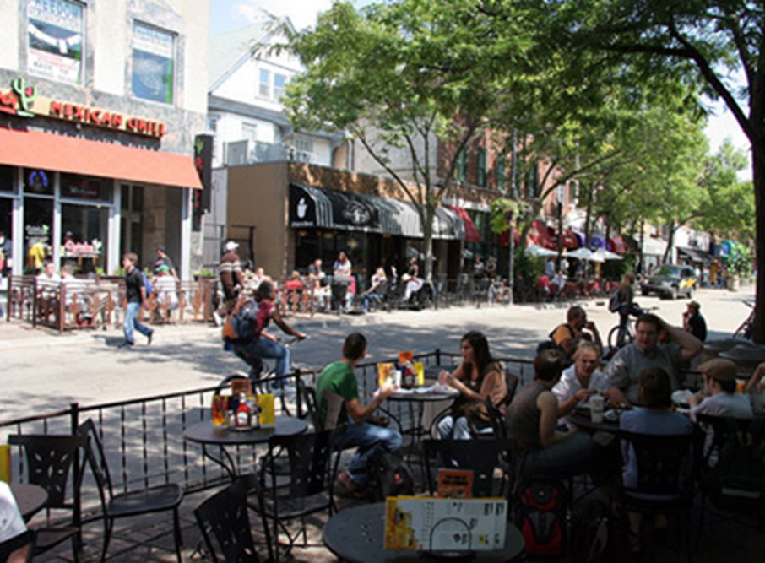
Impacts of Healthy Urban Design
Climate benefits
↓ CO₂ emissions
Other environmental benefits
↓ resource use
↓ land use
↓ water use
↓ regional air pollution
Health benefits
↑ physical activity
↑ social capital
↓ motor vehicle crashes
Notes:
Smart growth diagram: http://www.sherwoodinstitute.org/smart-growth-and-ahwahnee-principles/

Slide 61
Potential Impacts of Healthy Agriculture
Health benefits
↓ cardiovascular disease
↓ cancer
↓ pesticide exposure
Climate benefits
Reduced deforestation
Reduced fuel use in transportation
Other environmental benefits
Soil conservation
Water conservation
↓ pesticide use

Slide 62
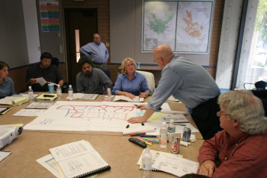
Health Impact Assessment
HIAs are a tool examine potential health impacts of proposed policies and projects
Ideally elected officials and other decision makers request information on potential health consequences of projects and policies as part of their decision-making process
Health officials use HIA to
facilitate their involvement
in policy and project decisions

Slide 63
Examples of HIAs on Climate Change Issues
Transportation Policy Recommendations in Climate and Energy Action Plan, Eugene OR
Review of Climate Action Plan Policy Recommendations in South Florida Region
California Cap and Trade Rulemaking
Urban Forest Canopy as a Climate and Health Adaptation, Ann Arbor MI
Heat Vulnerability in High-rise Condominiums, San Francisco

Slide 64
Conclusion
Building environment policies and practices affect health
Transportation
Buildings
Land use, forestry, agriculture
Choices to promote healthy built environments also promote resilience, mitigation, and adaptation to climate change
CO-BENEFITS

Slide 65
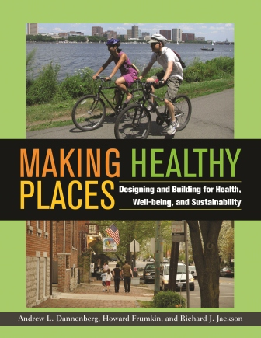
Making Healthy Places: Designing and Building for Health, Well-Being, and Sustainability
Andrew Dannenberg, MD, MPH
Howard Frumkin, MD, DrPH
Richard Jackson, MD, MPH
Island Press, 2011
www.makinghealthyplaces.com

Slide 66
Some Climate Change and Health Resources
American Public Health Association
www.apha.org
World Health Organization
www.who.int
Centers for Disease Control and Prevention
www.cdc.gov
US Environmental Protection Agency
www.epa.gov

